Slide 1
Technology and Its Effect on Student Motivation and Engagement in Physical Education
Michael Concepcion
CSIT 100
Professor Kaplun

Slide 2
The Role of PE
Cornerstone of general education and youth development
Physical activity is key to mental and physical health
>= 1hr a day
PE exists across K-12 and college
Cirriculum becomes more complex

Slide 3
The Problem
Declining Motivation & engagement in PE
Lack of interest in the cirriculum
Lack of confidence in one’s ability to perform well
Why traditional methods may not work anymore
Repetitive
Obligatory
Why this problem matters/Impact on students
Lack of motivation→Lack of Engagement→Poor Performance in Class

Slide 4

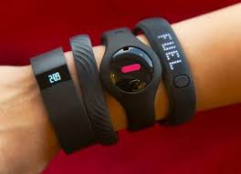
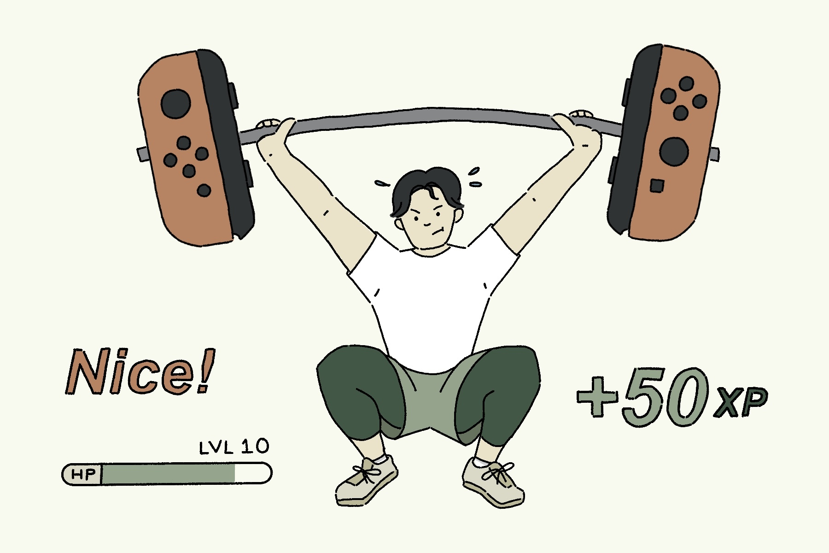
TECHNOLOGY: The Solution???

Slide 5
Theoretical Foundation: SDT Overview
The Self-Determination Theory (SDT) explains that people become motivated when satisfying their psychological needs of autonomy, competence, and relatedness
Autonomy: the need to feel in control of one’s OWN actions
Competence: the need to feel efficient and inclined to master tasks
Relatedness: the need to feel connected and cared for
Intristic Motivation: Motivation from within an individual
High interest in an activity
Extrinsic Motivation: Motivation from external factors
All three Needs→Intrinsic Motivation→Improved Engagement

Slide 6
SDT in Physical Education
Traditional PE classes share the same values as SDT
Students get to pick their own activities
Constructive Criticism leaves room for improvement without discouraging
Lots of time for positive social interaction with classmates
Problems in PE that undermine SDT
Strict Agendas
Too Difficult/Simple Tasks
feelings of exclusion and criticism
Understanding SDT allows teachers to properly integrate technology into class

Slide 7

Wearable Devices
Pedometers and even smart watches can keep track of an individual’s steps and energy expenditure.
Wearing such gadgets during class allows students to be in charge of their own fitness journeys
Challenges:
Accessibility
Preferrably for HS and College students

Slide 8

Online Learning Platforms
Remote way to monitor student progress
Freedom to choose when to do assignments
Quick Access to Constructive Criticsism
Discussion Boards to interact with others
Challenges
More Virtual than in person (Defeats the whole point of PHYSICAL Education)
Preferably limited to middleschool-College

Slide 9

Gamification
Implementing game elements into non-game contexts
Leaderboards
Point Systems
A study showed significant improvements in motivation and engagement when implementing gamification in a class.
Challenges
Relies on External Factors to maintain effectiveness
Chances of encouraging unhealthy competition

Slide 10
References
Brickwood, K.-J., Watson, G., O'Brien, J., & Williams, A. D. (2019). Consumer-Based Wearable Activity Trackers Increase Physical Activity Participation: Systematic Review and Meta-Analysis. JMIR mHealth and uHealth, 7(4). 10.2196/11819
Çakir, T., K, K. M., Asghar, S., Rajput, A., & Ahmed, S. M. (2025). Evaluating the effectiveness of gamification in physical education: enhancing engagement through play and movement. Retos, (64), 925-935. 10.47197/retos.v64.112788
McMillian, J. (2025, August). From Whistles to Wearables: How Technology Is Transforming K-12 Physical Education. Technology Tips, 96(6), 50-52. 10.1080/07303084.2025.2510163
Teixeira, P. J., Carraça, E. V., Markland, D., Silva, M. N., & Ryan, R. M. (2012, June 22). Exercise, physical activity, and self-determination theory: a systematic review. International Journal of Behavioral Nutrition and Physical Activity, 9(78). 10.1186/1479-5868-9-78

Slide 11
Thank you!
Questions?

